Slide 1
Expanded Access Use of for Investigational Drugs in VA: Focus on COVID-19
Office of Research Protections, Policy, & Education
VHA Office of Research and Development
Department of Veterans Affairs
March 18, 2020
Dial in: 1 (213)-929-4232
Access Code: 152-743-880
Slides in “Handout” Tab

Slide 2
Discussion Points
Dial in: 1 (213)-929-4232
Access Code: 152-743-880
Slides in “Handout” Tab
What is meant by expanded access to investigational drugs and biologics?
How does expanded access to investigational drugs and biologics apply to the COVID-19 pandemic?
  Remdesivir (Gilead Sciences, Inc.)
ORD’s Mechanisms for Supporting Expanded Access for COVID-19 Related Therapies
  Support center for facilitating questions about expanded access uses of investigational drugs and biologics
  Mechanism for VA clinicians from VA Facilities without Research Programs to use expanded access for investigational drugs and biologics related to COVID-19

Slide 3
What is Meant by Expanded Access to Investigational Drugs and Biologics?
Regulated by the U.S. Food and Drug Administration
Sometimes called “compassionate use”, expanded access is a potential pathway for a patient to gain access to an investigational drug or biologic for treatment outside of clinical trials
  when no comparable or satisfactory alternative therapy options are available
  with an immediately life-threatening condition or serious disease or condition

Slide 4
Common Pathways for Use of Drugs and Biologics
U.S. Drugs and Biologics
Approved Drugs and Biologics
Investigational Drugs and Biologics
(Non-Approved)
Use According to FDA Marketed Label
Off Label Use of Approved Drug
Commercial and
Non-Commercial Investigational New Drug Applications
Expanded Access
Right to Try

Slide 5
Key Points to Remember About Expanded Access Uses of Investigational Drugs or Biologics
Expanded access uses are not designed to replace clinical trials.
Industry/sponsors are not required to supply investigational drugs or biologics for expanded access uses; FDA does not make the decision.
The industry/sponsor decides what type of expanded access will be used for the investigational drug or biologic supplied.
All expanded access uses of investigational drugs or biologics either require IRB prospective approval or retrospective IRB notification and informed consent from the subject or subject’s legally authorized representative except in emergency use if specific federal regulations are met.
  Non-emergency use (prospective IRB approval)
  Emergency use (IRB notification 5 working days after the initial use of the investigational drug or biologic)

Slide 6
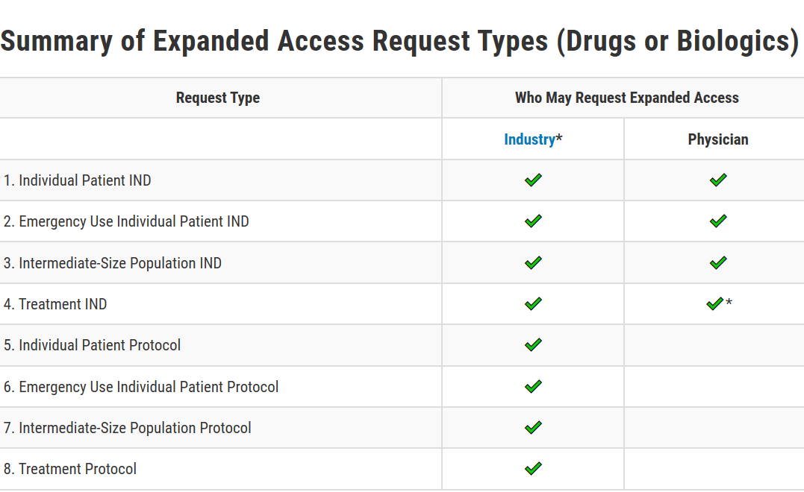
Summary of Different Types of Expanded Access: Drugs and Biologics
Source: https://www.fda.gov/news-events/expanded-access/expanded-access-how-submit-request-forms

Slide 7
The Expanded Access Program to Remdesivir
(Gilead Sciences, Inc.)
Gilead is currently only allowing access to Remdesivir:
  Clinical trials
  Expanded access: Emergency IND
Requests must be made by the patient’s lead treating physician.
Requests must be made through the Gilead portal at https://rdvcu.gilead.com/.
Prospective IRB approval is not required. However, any emergency use must be reported to the IRB within 5 working days after the initial administration of Remdesivir.
  If prospective IRB notification is required by your IRB or institution, you must follow those applicable local requirements.

Slide 8
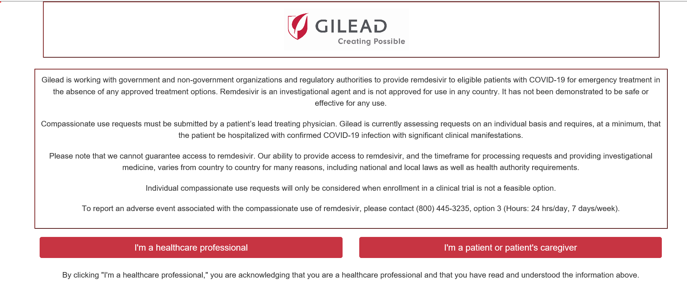
The Gilead Sciences, Inc. Expanded Access Website for Requesting Use of Remdesivir to Eligible Patients at https://rdvcu.gilead.com/
An exception is not needed when the single IRB requirement doesn’t apply.
The single IRB requirement applies to all federally conducted or supported non-exempt human subjects research involving more than one (1) institution engaged in human subjects research. The single IRB requirement does not apply if the non-exempt human subjects research involving the VA and another engaged institution is
  Not funded or supported by VA or another Federal agency or department at the other non-VA institution, or
  The other non-VA institution is not another federal agency or department’s institution.

Slide 9
Criteria That Must Be Met in Order to Submit a Compassionate Use Request to Gilead for Remdesivir
Key inclusion criteria
  Hospitalization
  Confirmed SARS-CoV-2 by PCR
  Mechanical ventilation
Key exclusion criteria
  Evidence of Multi-organ failure
  Pressor requirement to maintain blood pressure
  ALT levels > 5 X ULN
  Cr Clearance <30 mL/min or on renal replacement therapy
  Remdesivir cannot be used in conjunction with other experimental antiviral agents for COVID-19
  Pregnancy or breastfeeding
  These criteria are subject to change without notice and may be subject to additional considerations and limitations. If your patient does not meet these minimal criteria, please do not submit a request at this time. Please note that meeting these minimum criteria does not guarantee approval of a request for remdesivir.​

Slide 10
Expanded Access Process for Remdesivir
Gilead Sciences, Inc.
Review patient information to ensure the patient meets the criteria established by Gilead.
Access the Gilead portal at https://rdvcu.gilead.com/
If approved, Gilead will email instructions to you as the physician to complete:
  Contact your Pharmacist and IRB immediately. ORD also recommends informing your Chief of Staff.
  Gilead will send a Confidentiality Disclosure Agreement (CDA) to complete.
  You must obtain an investigator-sponsored, single-patient emergency Investigational New Drug (eIND) Request prior to Gilead shipping the drug.
    Obtain the emergency IND forms (Form FDA 3926) from the FDA website at https://www.fda.gov/news-events/expanded-access/expanded-access-how-submit-request-forms#PhysicianEmergency-sbs
    Call FDA.
  FDA contact number M-F day (8:00-4:30): 301-796-3400
  After hours / weekends: 866-300-4374
  Gilead will send a Prescribers Agreement (PA) for signature.
  Include the sex of the patient with the Prescriber’s agreement.

Slide 11
Expanded Access Process for Remdesivir
Gilead Sciences, Inc. (cont.)
After Gilead receives the required information, Gilead ships the investigational drug to your VA Facility’s pharmacy.
Complete a VA Form 10-9012: Investigational Drug Information Record to give to the VA Facility’s pharmacy (this can be done prior to Gilead shipping the investigational drug).
The physician obtains informed consent from the subject or the subject’s legally authorized representative unless the regulatory requirements are met for an exception from informed consent (if permitted by Gilead).
*Obtain a HIPAA authorization from the patient or patient’s legally authorized representative if possible.

Slide 12
Expanded Access Process for Remdesivir
Gilead Sciences, Inc. (cont.)
A prescription must be entered for the patient.
The pharmacist dispensing the drug verifies that a signed informed consent was obtained or verifies through an alternate mechanism that the signed document was seen before dispensing for the fist time.
After drug is administered, the physician must notify the IRB in writing within 5 days after treatment initiation. This usually includes (but varies depending upon the IRB):
  Summary of the conditions constituting the emergency
  Patient outcome information
  Human subject protection measures that were followed (e.g., informed consent).

Slide 13
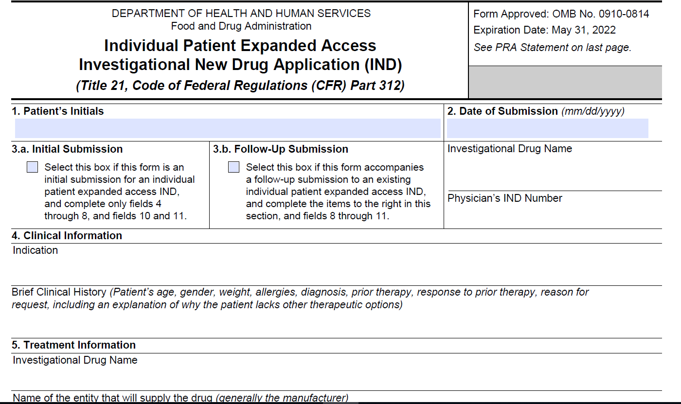
Form FDA 3926

Slide 14
What Research Committees or Subcommittees are Required to Review or Approve When a VA Physician Wants to Request an Investigational Drug or Biologic Related to COVID-19 Through Expanded Access?
Emergency IND
(Example: Remdesivir)
No Prospective IRB Approval
IRB Notification Required 5 Working Days After Beginning Administration
No VA Research and Development Committee approval
Prospective IRB Approval Required
Prospective VA Research and Development Committee approval Required
*Designated Review can be used when a single patient use is approved by the IRB Chair or another appropriate IRB voting member as permitted by FDA.
Non-Emergency Expanded Access

Slide 15
Support Center for Facilitating Questions about Expanded Access Uses of Investigational Drugs and Biologics: COVID-19
ORD is staffing a dedicated support center to assist VA Facilities with resolution of issues related to expanded access uses of Investigational Drugs and Biologics related to COVID-19.
ORD is collaborating closely with Pharmacy Benefits Management (PBM) and other program offices as part of this support center.
ORD will be announcing how to contact the ORD Expanded Support Team. In the interim, please continue to send questions to ORDCOVID19@va.gov.

Slide 16
Mechanism for VA Clinicians from VA Facilities without Research Programs to use Expanded Access for Investigational Drugs and Biologics Related to COVID-19
All expanded access uses of investigational drugs or biologics require an IRB.
VHA has 31 Medical Centers that do not have research programs.
ORD and the Office of Research Oversight (ORO) have developed a mechanism that will permit VA Medical Centers without Research Programs to be able to use expanded access for investigational drugs and biologics related to COVID-19 for their patients.
ORD is working to stand up this mechanism by next week pending finalizations of the procedures and agreements.

Slide 17
Steps for VA Facilities without Research Programs to use Expanded Access for Investigational Drugs and Biologics Related to COVID-19
The Medical Center Director is required to sign and return to ORD:
  VA Special Assurance (VSA) for Providing Expanded Access to COVID-19 Investigational Products by VA Facilities that Do Not Hold a Federalwide Assurance (FWA);
  Memorandum of Understanding (MOU) with the VHA Central Office Human Research Protection Program for use of the VA Central IRB; and
  MOU with the Baltimore VA for use of the Baltimore Research and Development Committee
ORD will assist the VA Facility with implementing the standardized written procedures for use of the VHA Central IRB and the Baltimore VA Research and Development Committee.

Slide 18
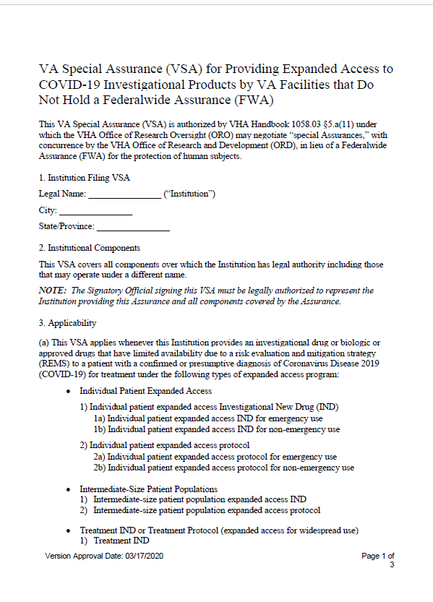
VA Special Assurance (VSA)

Slide 19
VA Special Assurance
Limited Assurance: It only applies for treatments related to COVID-19
The terms require the VA Facility to:
  Comply with all applicable FDA regulations applicable to the expanded use;
  Comply with all applicable VA and VHA policies applicable to the use;
  Adopt and implement written procedures developed by ORD for providing expanded access to COVID-19 investigational products;
  Rely upon the VHA Central Office IRB for review and prior approval of any non-emergency expanded access, and review of any expanded access under this VA Special Assurance. An IRB Reliance Agreement for this VHA Central Office review has been established by ORD; and
  Rely upon the Research & Development Committee designated by ORD for review and prior approval of non-emergency expanded access under this VA Special Assurance.

Slide 20
Expanded Access Support for VA Facilities without Research Programs
There are multiple regulatory and process requirements when using expanded access. Delays occur when it is unclear what to do to meet the requirements for expanded access.
  IRB
  R&D Committee (for non-emergency)
  Agreements
  Pharmacy coordination
  Industry/sponsor coordination
To support VA Facilities without FWAs, ORD will be assigning a coordinator to assist when a VA physician from a VA Facility without a research program is planning to use expanded access for a COVID-19 related investigational drug or biologic.

Slide 23
Steps for VA Facilities without Research Programs to use Expanded Access for Investigational Drugs and Biologics Related to COVID-19
The VA Facility clinician will contact ORD for each use.
ORD will assign an individual who will work with the VA Facility clinician to facilitate completion of all industry requirements and assist with submission of required documents to the VHA Central Office IRB and Baltimore VA Research and Development Committee as applicable to the type of expanded use.
The ORD facilitator will also assist with ensuring any reporting requirements from the sponsor or FDA are also completed after administration of the investigational drug or biologic under the expanded use.

Slide 24
EA Navigator: Reagan Udall Foundation for the FDA
Created by Congress to support the FDA in its mission to promote public health and improve regulatory science
Asked by FDA and others to create an online platform to provide clear, factual information about Expanded Access (EA), including links to companies offering EA for their investigational drugs

Slide 25
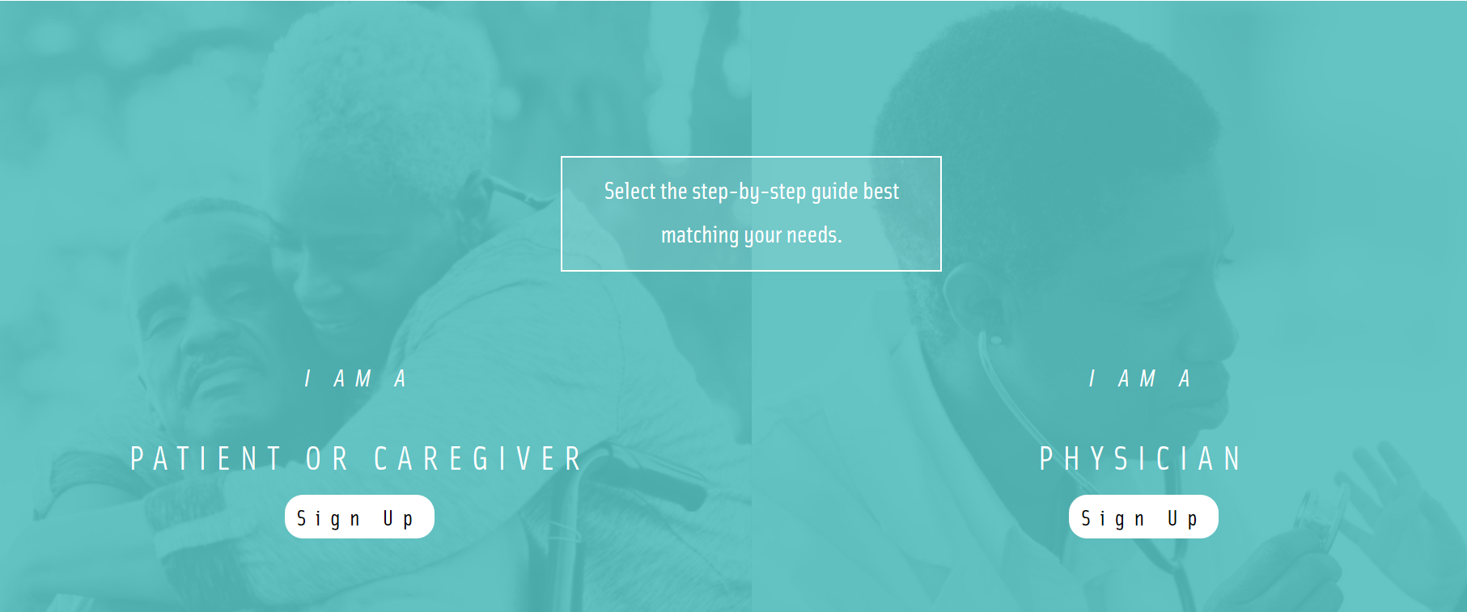
Expanded Access Navigator https://navigator.reaganudall.org/

Slide 26
Summary
With the current COVID-19 pandemic, we are expecting different investigational drugs and biologics to be made available through an expanded access pathway.
Multiple program offices and VA Medical Facilities are working together to support all VA Medical Facilities for use of investigational drugs and biologics related to COVID-19 made available through expanded access.

Slide 27
Important References
Expanded Access Navigator
https://navigator.reaganudall.org/
FDA’s expanded access contact information
https://www.fda.gov/news-events/expanded-access/fdas- expanded-access-contact-information
FDA’s expanded access webpage
https://www.fda.gov/news-events/public-health-focus/expanded-access
FDA’s expanded access on how to submit a request (forms)
https://www.fda.gov/news-events/expanded-access/expanded-access-how-submit-request-forms#PhysicianEmergency-sbs

Slide 28
Questions?
Presenter:
C. Karen Jeans, PhD, CCRN, CIP at c.karen.jeans@va.gov
Director of Regulatory Affairs, ORPP&E
VHA Office of Research & Development
202-443-5712
Send questions to:
ORDCOVID19@VA.GOV

